Slide 1
CIS is a global community with two parts: best practices and an operational side through MS-ISAC and EI-ISAC, federally funded by DHS. Activities that CIS shares in this tech forum are not shared in election related forums
Albert Sensors
Provided by Center for Internet Security (CIS). Source brief is from 2019 at YouTube link below
https://www.youtube.com/watch?v=wUyPXEJzn88&t=4s

Slide 2
https://www.youtube.com/watch?v=wUyPXEJzn88&t=4s
2019 AWS Public Sector Summit – Washington DC (YouTube)

Slide 3
Albert Sensors
County Level & State Level through Memorandums of Agreement (MOA) with (CIS) or
Cybersecurity and Infrastructure Security Agency (CISA), part of DHS
2019 Source: https://www.youtube.com/watch?v=wUyPXEJzn88&t=4s
Two main services of Albert, stated by CIS: Net Flow Analysis and Network Intrusion Detection
According to Brian Calkin, CTO of CIS “more capabilities are there in CIS” (listen carefully as he give a summary brief), 24/7 analysis center, intelligence team, wide variety of services
Sensors are deployed at the network edge, behind what ever handles the network address translation, commonly behind the firewall or core router. “Literally monitoring all traffic incoming and outgoing traffic in and out of an organization,” Brian Calkin CTO of CIS
IDS engine, Dell 1U server, Oracle OS with other OS software fully deployed, and maintained by CIS.
Can share data with Federal Agencies who themselves can share per the MOA; 6 months of data stored
10 to 100Gig sensors, sends log flow and log data to East Greenbush, New York Security Operation Center (SOC) analysts. Stored on the AWS cloud.
They ‘remediate as needed’ according to what they think is important, if signatures match their library of malware signatures or perhaps other reasons.
Deep packet inspection records, can be queried by individual sensor
Central storage “data lake” uploads to AWS, less than 5 minutes latency from sensor to SQL query Amazon Athena), artificial intelligence

Slide 4
https://www.youtube.com/watch?v=wUyPXEJzn88&t=4s
2019 AWS Public Sector Summit – Washington DC (YouTube)

Slide 5
https://www.youtube.com/watch?v=wUyPXEJzn88&t=4s
2019 AWS Public Sector Summit – Washington DC (YouTube)

Slide 6
Albert Sensors
Net Flow is a record of all communications that has happened across a network. Net Flow is ”like a phone bill” seeing the date, time and length of a call but not the conversation. We do not know what else the software on the sensor is doing though. CIS likes to run ad hoc queries on this data.
Network Intrusion detection. Devices use open source Suricata IDS engine. Sensors generate security events, sent to 24/7 SOC analysts in New York.
Databases of ransomware and other attacks already exist and have been in use for years without CIS.
Not all events are escalated back to the locality (50% escalated per month, 5K in 2019). CIS does not fix or prevent intrusions.
CIS MOA services are ‘combined NetFlow and intrusion detection system monitoring, with analysis of related data; event notification and delivery; and management of associated devices, including all hardware and software necessary for service delivery. Also referred to as “Services”’
MOA requires detailed Pre-Installation Questionnaire (PIQ), “Provide public and private IP address ranges including a list of servers being monitored including the type, operating system and configuration information, as well as a list of IP ranges and addresses that are not in use by XXX Entity (DarkNet space);” source: MOA between CIS and Prince William County, VA

Slide 7
Albert Sensors
Taken from an online discussion about Albert sensors, (names withheld):
“We utilize tools like this from time to time when in an incident. I would like to see what data actually is collected before I make a judgement. I do agree though that a device managed by a third party controlled by the Federal Government is scary. Things like netflow data likely could not be weaponized. Other captures such as full packet captures are much more dangerous.”
Reply to the above:
…”not only packet captures, but the sensors are connected to through a VPN, giving direct access to all network traffic. MAC spoofing and other ‘tricks’ are trivial for knowledgeable people once they’re inside, as you know. County IT has no way to control what goes on inside those ‘sensors’ that the gov is putting in their networks. I would drop-kick thing out of my network.”

Slide 8
Albert Sensors plus Additional Services
Entities with Albert are also part of the Continuous Diagnostics-and-Mitigation and Identity and Access Management ”through four capabilities; trust determination for people granted access (TRUST), security-related behavioral training (BEHAVE), credentials and authentication (CRED), management and control of account and access privileges (PRIV). These four capabilities have significant interdependencies and are managed together as part of the IDAM capability area.” source: https://www.cisa.gov/sites/default/files/publications/2021-05-26_CDM%20Identity%20and%20Access%20Management%20Fact%20Sheet.pdf
A list of assets and their access/credentials may be leaving the localities and be being sent to CISA or CIS.
Mona Harrington, the acting assistant director of CISA’s National Risk Management Center noted,
“that all 50 states have deployed CISA-funded or state-funded intrusion detection sensors in their systems, known as Albert sensors, and that hundreds of election officials and private sector election infrastructure partners have signed up for a range of CISA’s cybersecurity services, from recurring scanning of their systems for known vulnerabilities on internet-connected infrastructure to more in-depth penetration testing.”
Source - https://gcn.com/cybersecurity/2022/09/election-officials-have-been-largely-successful-deterring-cyber-threats-cisa-official-says/376745/ , Sept 6, 2022

Slide 9
Albert Sensors
The EI-ISAC member list has 3,217 members covering 55 states and territories. 40 vendors are members including all of the major electronic voting system vendors plus Pro V&V and SLI. 6 NGO’s are members including Democracy Works (funded by Open Society et al and tied to Facebook and Twitter GOTV efforts), ERIC, NASS, and NASED. It is unclear whether or not members have access to any of the data obtained by CIS.
Level 1 maturity is required by CIS before Levels 2 and 3 tools (Albert) can be used. Technically the information required for Level 1 maturity is not needed for an IDS sensor to be installed. This raises the question over why CIS needs Level 1 information before Albert is placed on the network.
There are downloadable worksheets in the Level 1 Security Model prioritization page that are very detailed with information like software, licenses, usernames, computer hardware, computer serial numbers, etc., none of which is needed for an IDS sensor. https://docs.cisecurity.org/en/latest/maturity/maturity_bp_mapping_L1.html#maturity-mapping-to-bp-maturity-one-description
There is a Traffic Light Protocol developed by CISA that limits what can be released to the public.

Slide 10
Albert Sensors WHY?
Many tools are readily available to the counties and states, already filled with thousands of cyber security people, for detecting and preventing network intrusions.
CIS’s goal is machine learning, which is “a branch of artificial intelligence (AI) and computer science which focuses on the use of data and algorithms to imitate the way that humans learn, gradually improving its accuracy, ” source IBM.com. Are they trying to predict future malware or is it something else?
Albert sensors are deployed in localities, with precinct election data (likely), voter registrations, etc., being monitored, i.e., “election entities.”
Promotes centralized collection and monitoring of a wide range of data. The MOAs are written generally where services and monitored networks can be added without amendment.
We are allowing the federal government and these organizations to breach the security of the states and counties to protect the states and counties? AND the federal government has been hacked/breached how many times?
These sensors could easily be intentional or even unintentional trojan horses in which a breach would be on a massive scale.

Slide 11
Albert Sensors WHY? MACHINE LEARNING

Slide 12
Albert Sensors- Virginia
ELECT provides technical advisories for login to the Election Infrastructure Assessment Tool (EIAT) from CIS, around the time of the March security plan update to the State Board, required by law. The question is what information, detailed or general, is being provided to CIS through EIAT or other tools BEFORE Albert is installed?
Fairfax does not have Albert but may be monitored through the Albert at the state level (VITA MOA). ES&S also has an agreement with CIS, and is used in Fairfax.
Loudoun election office is responding to these emails and asked to be in the CIS situation room for the midterms.
PWC not responding to CIS that we can see. However, the PWC-ELECT network is set up by the school system which would fall under the possible list of networks monitored.
The Electoral Board is not on distribution for the emails to or from CIS in ether county.
Funding is being sought by the grant administrators and others in the county: MWCOG, NVERS, VDEMA, etc.

Slide 13
Albert Sensors- Virginia
https://law.lis.virginia.gov/vacode/title24.2/chapter4/section24.2-410.2/
“B. The electoral board of each county and city that utilizes supporting technologies to maintain and record registrant information shall develop and annually update written plans and procedures to ensure the security and integrity of those supporting technologies. All plans and procedures shall be in compliance with the security standards established by the State Board pursuant to subsection A. Each electoral board shall report annually by March 1 to the Department of Elections on its security plans and procedures. The general registrar and the Department of Elections shall provide assistance to the electoral board, upon request by the electoral board.”

Slide 14
Albert Sensors - Virginia
The MOA for Prince William County, VA is signed by a representative of its IT department.
We still do not know if the Electoral Board, responsible for security of elections, even knows or knew that the MOA went into place. The Board of County Supervisors did not as they do not approve grant money.
Does this county IT person have the legal authority to commit the election process and all its tools, processes, and communications to be monitored?
Terms and conditions of MS-ISAC and EI-ISAC membership seem to data give sharing permission even if at first it reads like the entity is protected from having their data shared,
MS-ISAC Terms: EI-ISAC Terms: Privacy Notice
The 2020 300,000-vote difference, https://wwrkds.net/wp2/va-2020-election-analysis-report/ that former ELECT Commissioner Piper called ‘a mistake,’ could have been caused through the backdoor of Albert. (Michigan had over 1 million vote ‘mistake’)

Slide 15
Albert Sensors - Virginia
The MOA for the Commonwealth of Virginia is signed by the CIO of the Virginia Information Technology Agency (VITA), 2016. VITA provides services to executive branch agencies, including the Department of Elections, DMV, State Board of Elections. Those networks are presumably monitored by Albert; voter registrations, election results, etc.
ELECT requires in its policy document, LOCALITY ELECTION SECURITY STANDARDS 2022, (pg. 14 0f 55) that localities will be cut off from VERIS if they are not members of MS-ISAC and EI-ISAC. The MS-ISAC relationship is noted as a ‘pilot program’ on ELECT’s website.
To improve risk communications and strive for continual improvement, each locality: a. Is a member of the Center for Internet Security (CIS) Elections Infrastructure Information Sharing & Analysis Center (EI-ISAC) and/or Multi-State ISAC(MS-ISAC). b. Completes a self-assessment annually as requested by the Department of Elections, utilizing a tool based on best practices (i.e. NIST, CIS Top 6-20,etc.).
ELECT provides technical advisories for login to the Election Infrastructure Assessment Tool from CIS, around the time of the March security plan update to the State Board, required by law. The question is what information, detailed or general, is being provided to CIS through EIAT?

Slide 16
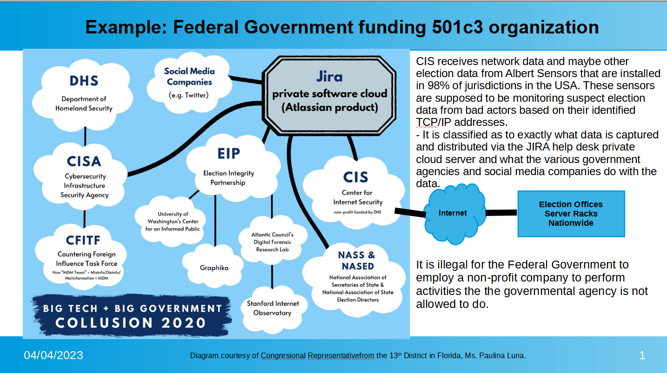
Congresswoman Luna’s Slides During Questioning of Twitter in March 2023

Slide 17
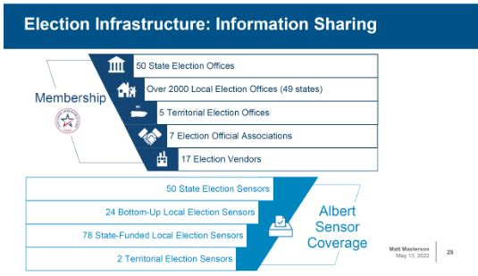
May 2022 EI Info Sharing Status

Slide 18
A 2023 CIS presentation on CIS best practices.
https://youtu.be/8gVwZ5_Sjlk
“Even though elections are state run, elections infrastructure is managed differently than the states….” - minute 1:53
“We are the only ISAC fully funded by the federal government. So, we are an extension of the federal government” - minute 2:22
Phyllis Lee, Senior Director for CIS

